Slide 1
Customer Churn prediction
By - Rigved Jagdish Tupsakhare

Slide 2
objective
The objective of customer churn prediction is to develop a predictive model that can accurately forecast which customers are likely to leave a business or discontinue using its products or services. By analyzing historical data and identifying patterns and indicators associated with customer churn, businesses can proactively implement retention strategies to mitigate churn and maintain customer loyalty, ultimately leading to improved profitability and sustainable growth.

Slide 3
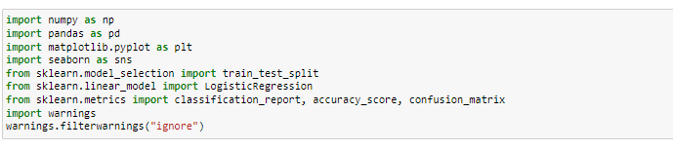
Importing Libraries

Slide 4
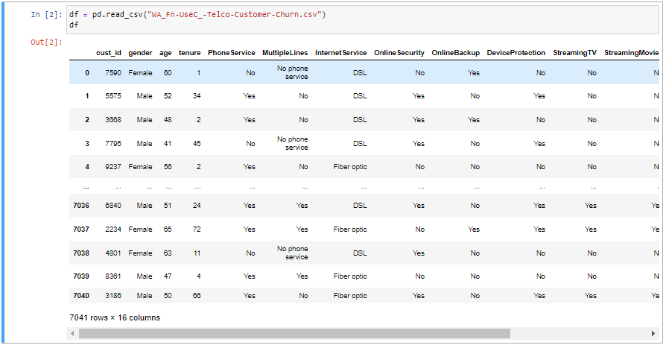
Reading the csv as Dataframe

Slide 5
features description
Gender: Categorical variable representing the gender of the customer.
Age (numeric): Numeric variable representing the age of the customer.
Tenure (numeric): Numeric variable representing the duration of the customer's tenure or subscription.
PhoneService: Categorical variable indicating whether the customer subscribes to phone service.
MultipleLines: Categorical variable indicating whether the customer has multiple phone lines.
InternetService: Categorical variable indicating the type of internet service subscribed by the customer.
OnlineSecurity: Categorical variable indicating whether the customer has online security service.
OnlineBackup: Categorical variable indicating whether the customer has online backup service.
DeviceProtection: Categorical variable indicating whether the customer has device protection service.
StreamingTV: Categorical variable indicating whether the customer has streaming TV service.
StreamingMovies: Categorical variable indicating whether the customer has streaming movies service.
Contract: Categorical variable indicating the type of contract the customer is on (e.g., month-to-month, yearly).
MonthlyCharges (numeric): Numeric variable representing the monthly charges incurred by the customer.
TotalCharges (numeric): Numeric variable representing the total charges incurred by the customer.
Churn: Binary variable indicating whether the customer has churned (cancelled their subscription).

Slide 6
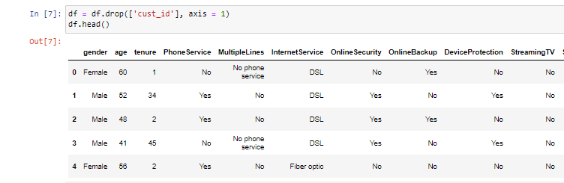

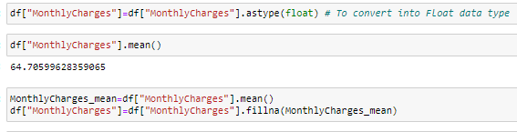
Exploratory data analysis
Removing Cust_id column as it has nothing to do with the analysis of churn.
Replacing “?” with Mean value in MonthlyCharges column.

Slide 7
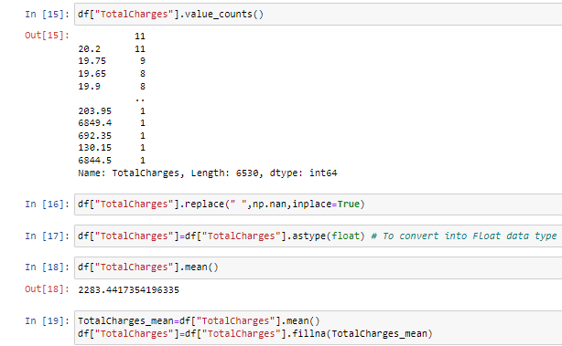
Exploratory data analysis
Replacing empty space with mean in TotalCharges column.

Slide 8
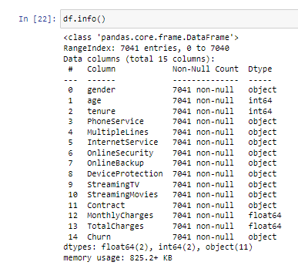
Information about the DataFrame

Slide 9
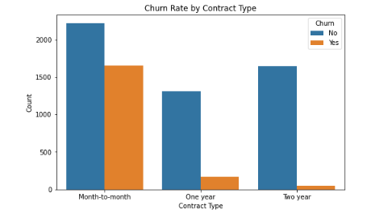
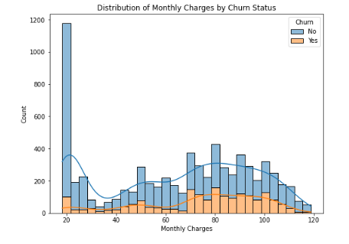
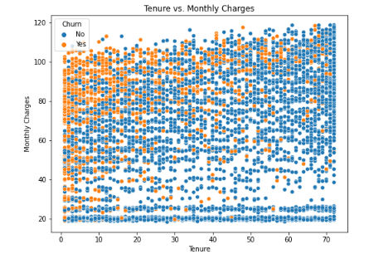
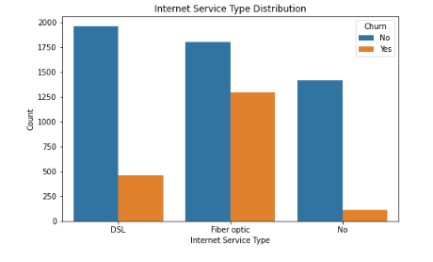
Visualizing the data

Slide 10
insights
The churn rate in month-to-month contract is high.
When monthly charges go above 60 there is rise in churn rate.
But that is only in initial period that is in month-to-month contract period.
As the tenure increases the churn rate significantly decreases.
There is low churn rate in one and two year contracts.
Monthly churn rate needs to be decrease so that customer will continue with service.
Hence there is need of improvement in initial period of subscription.
And churn rate in fiber optic service is also high .Hence, there is need of improvement in fiber optic service as well.

Slide 11
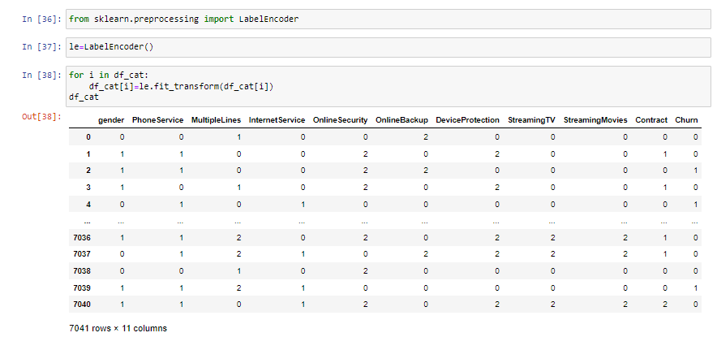
Encoding the categorical data

Slide 12
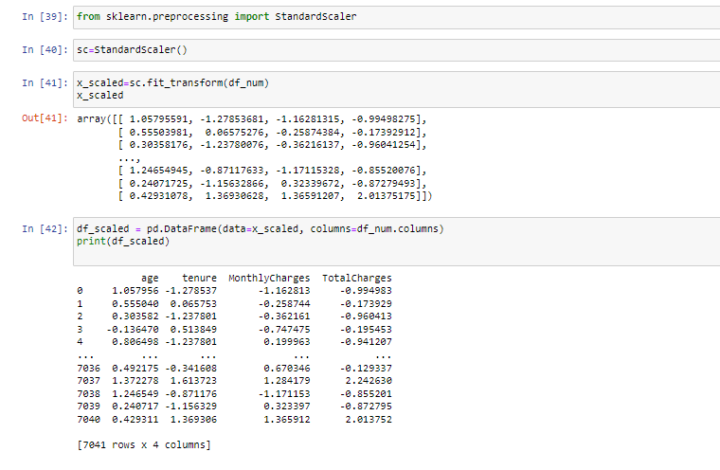
Feature scaling numerical columns

Slide 13
EDA is done and now we can move to machine learning

Slide 14
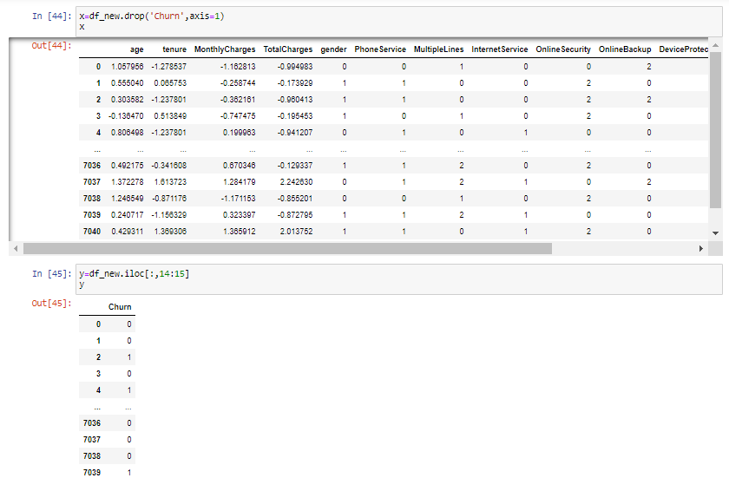
Splitting the dataframe into x and y

Slide 15

Splitting dataset in train and test

Slide 16
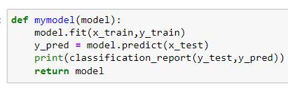
Model Building

Slide 17
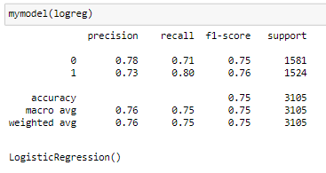
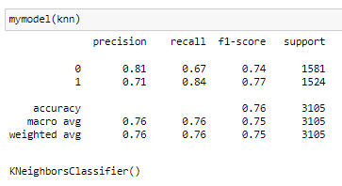
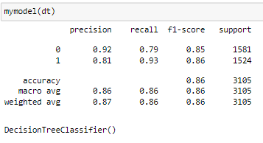
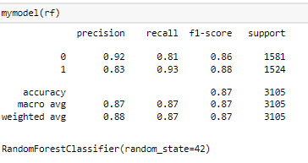
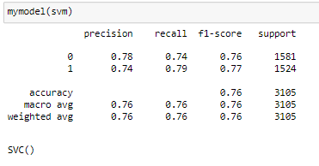
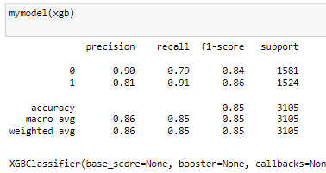
Model evaluation
Logistic Regression
KNeighorsClassifier
DecisionTreeClassifier
RandomForestClassifier
SVM
XGBClassifier

Slide 18
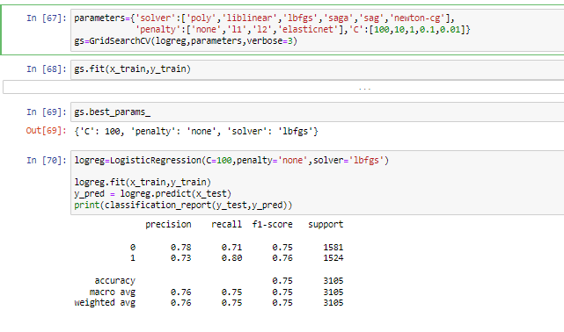
Hyper Tuning
Tuning LogisticRegression

Slide 19
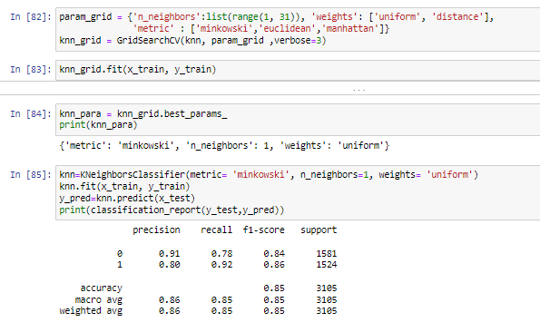
Tuning KNeighorsClassifier

Slide 20
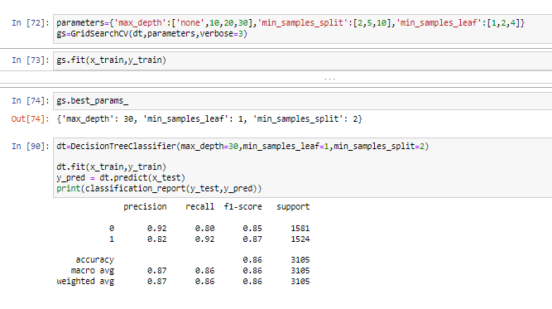
Decision tree pruning

Slide 21
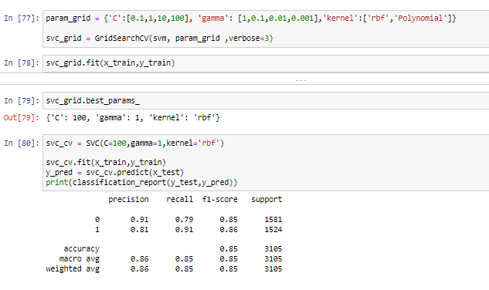
Tuning SVC

Slide 22
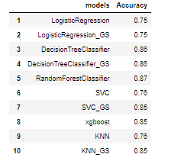
Evaluating the model performance

Slide 23
Conclusion
In conclusion, RandomForestClassifier achieves the highest accuracy of 0.87, closely followed by DecisionTreeClassifier and tuned DecisionTreeClassifier, both achieving an accuracy of 0.86. These tree-based models demonstrate strong predictive performance, likely due to their ability to capture complex relationships within the data.

Slide 24
Thank you

